Slide 1
ROLE OF ARTIFICIAL INTELLIGENCE in marketing
Artificial Intelligence is Revolutionizing Marketing

Slide 2
Group Members
Taimoor Ul Islam 14031
Malik Rayan 00000

Slide 3
Table of Contents
Background
The growing role of AI in marketing
How marketers use AI today
How AI enhances programmatic advertising
Understanding AI-related concerns in marketing
Final thoughts

Slide 4
BACKGROUND
What is Artificial Intelligence and Machine Learning?
What does a marketer do?
How AI can do job of a marketer?

Slide 5
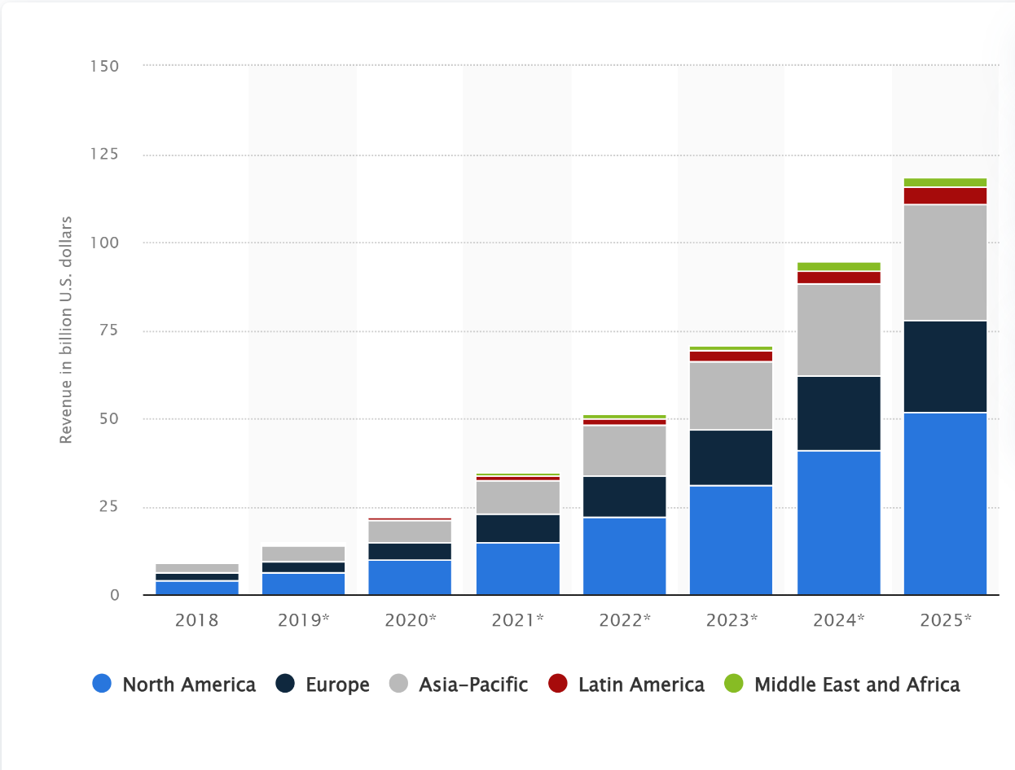
THE GROWING ROLE OF AI IN MARKETING
In 2020, the market for artificial intelligence technologies in marketing was valued at just over $12 billion
According to experts, the market for AI in marketing will exceed $35 billion next year, nearly tripling in size in only four years.
Another four years later, in 2028, industry insiders believe that this area of the marketing industry will have tripled once again.

Slide 6
HOW MARKETERS USE AI TODAY
Automation of repetitive tasks
Analysis of large quantities of data
Personalization of campaigns
Predicting conversion rates
Optimizing the timing of email marketing

Slide 7
AI ENHANCING PROGRAMMATIC ADVERTISING
Machine Learning Algorithms (ML) learns by analysing the outcomes of collected data
Helps Finding the target audience
Machine Learning algorithms helps automating the ads on relevant digital spaces
ML can see the trends

Slide 8
AI RELATED CONCERNS
Protection of privacy:
AI and ML rely on large quantities of data but can't act against its policies
Only collects data about user's behaviour and website analytics.
Marketers should ensure being ethical with collected data and usage practices and comply with CCPA and GDPR
Job security of Marketers:
Experts Believe AI and ML will not replace but change the existing jobs
Marketers can work more efficiently and effectively

Slide 9
Final thoughts
Online Feedback is useful
AI has the potential to transform the Marketing Industry
Marketers can overview the analytics of their website done by AI

Slide 10
THANK YOU
If You have any question feel free to ask.

